Slide 1
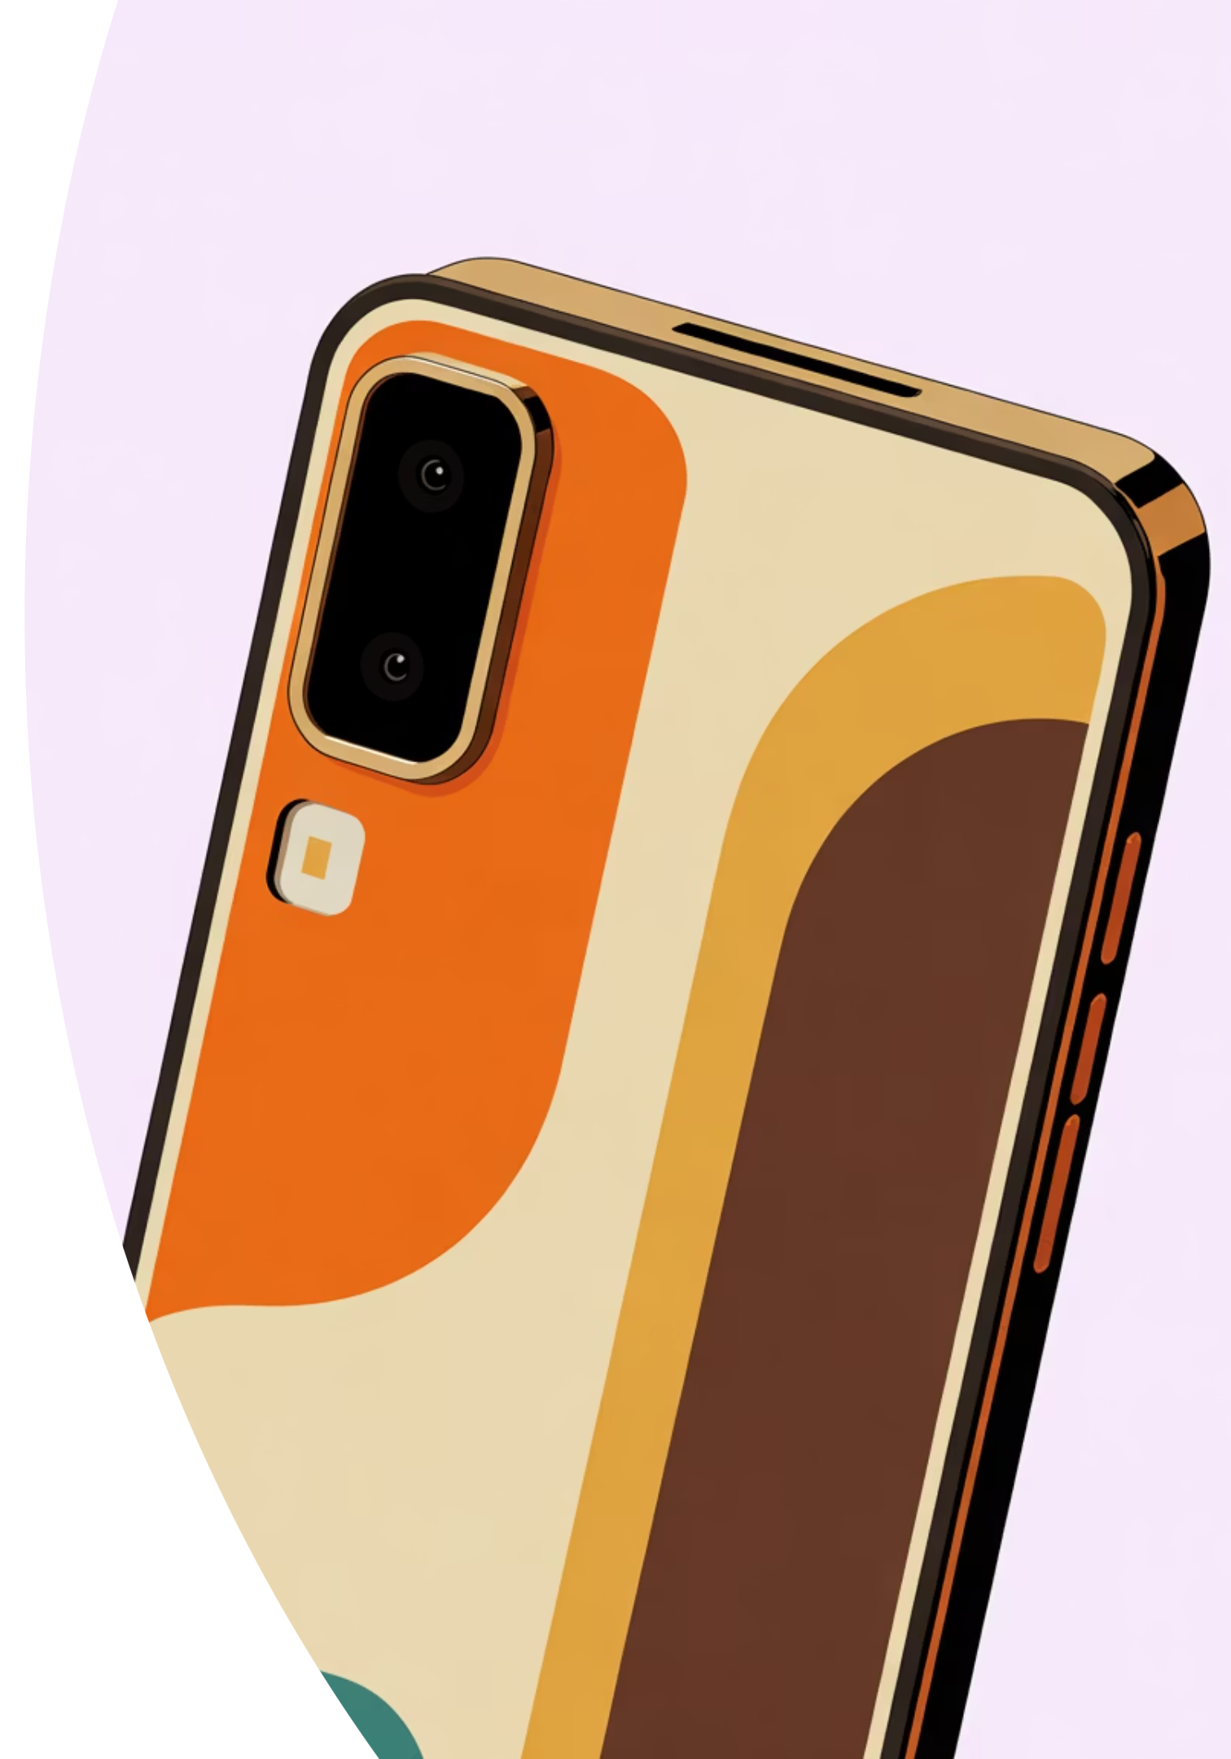
Don't Just Upgrade Your Phone
Upgrade Your Statement
RMDU Mobile — The Future of Mobile Discovery

Slide 2

The Problem We Solve
Shopkeepers prioritize profit margins over your needs. You're sold features you'll never use, premium specs you don't need, and phones that drain your wallet. The mobile buying experience is broken—driven by commission, not clarity.
It's time for transparency.

Slide 3

Buy Smart
Not for their profit. For your performance.
Before RMDU
Biased recommendations
Hidden trade-offs
Overpaying for features
With RMDU
Honest guidance
Full transparency
Perfect fit, real value

Slide 4


Our Intelligent Solution
RMDU delivers honest, segment-based mobile recommendations built on real performance data, transparent value analysis, and your actual needs—not retailer margins.
Real Performance Metrics
Benchmark data from independent reviewers and actual user performance, not marketing claims.
Unbiased Recommendations
No brand partnerships, no commission bias. Pure recommendations based on your priorities.
Price-to-Value Analysis
See what you're truly paying for and if the premium is worth your investment.

Slide 5





Five Perfect Categories
Every phone tells a story. Find yours.
Budget Killer
Gaming Guru
Camera Champ
Maximum value without compromise
Built for peak performance gaming
best camera performance mobile in segment
Battery Boss
GOAT
All-day power that lasts longer
The all-around leader in every way

Slide 6

Available Mobile Brands on RMDU
At RMDU Mobile, we feature only the top-performing and most trusted smartphone brands — hand-picked through honest testing, verified reviews, and real-world user experience.
We don’t promote brands. We promote the right phone for you.
💎 Premium Flagships
🎮Performance &Gaming Masters
💸 Budget & Value Leaders
Apple
Redmi
Samsung Galaxy Series
ASUS ROG
Realme
Poco
OnePlus Nord Series
OnePlus
Infinix
iQOO
Nothing Phone
Tecno
Motorola
“Every brand. One platform. Real performance — not promotion.”

Slide 7

Built on Transparency & Trust
Verified User Reviews
Zero Brand Bias
Real ownership experiences from verified purchasers, not influencer testimonials or brand partnerships.
We earn nothing from what you choose. Your satisfaction is our only metric for success.
Regular Updates
Coming Soon………..
Market changes fast. Our data refreshes continuously to reflect current prices, new releases, and evolving performance standards.
Every device on RMDU Mobile includes experiences shared by real users — not marketing scripts.Authentic feedback from past buyers helps you make confident, informed decisions.

Slide 8
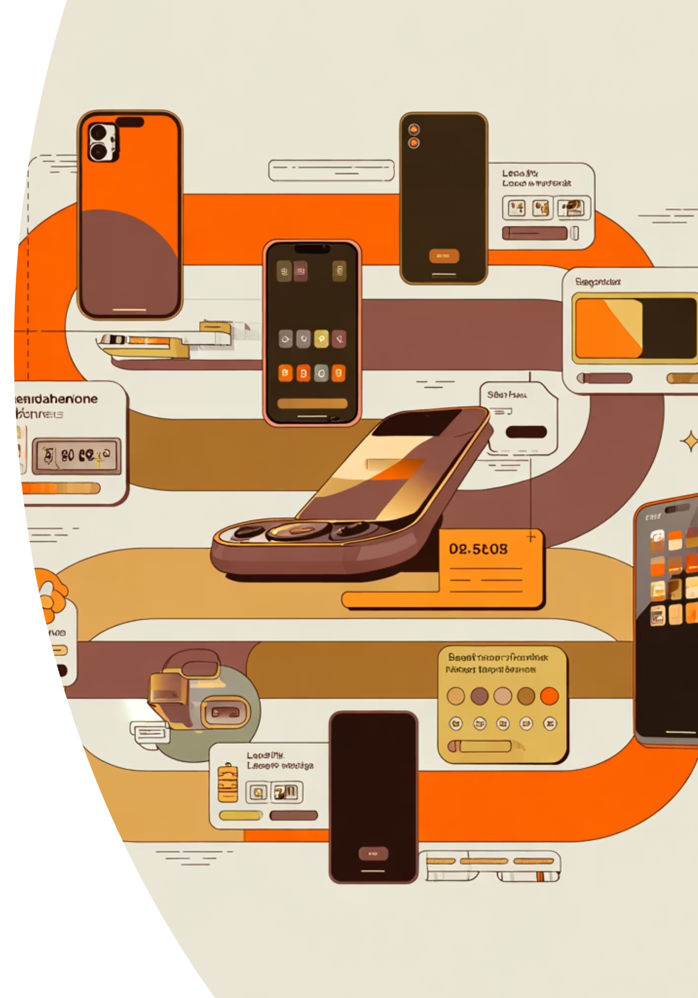
Your Path to the Perfect Phone
Answer Your Priorities
1
Tell us what matters: budget, gaming, photography, battery life, or all-around excellence.
Explore Smart Matches
2
View phones ranked by your needs with clear performance metrics and transparent pricing.
Compare with Confidence
3
Deep-dive comparisons show real differences, honest trade-offs, and long-term value impact.
Get Shopkeeper Card
4
Receive a curated recommendation card to show local retailers—backed by data, not sales pressure.

Slide 9

The Premium Experience
Where Design Meets Purpose
Premium UI that's beautiful and functional. Every interaction feels intentional. Every recommendation feels personal.
Fast. Honest. Unbiased.
No confusion. No regret. Just the right phone for you.

Slide 10

We Don't Sell Phones
We help you buy the right one.
RMDU Mobile
Upgrade Your Statement

